Slide 1
Air Pollution in Germany
Finn Dumke, Jonas Schaaf, Lennart Klose, Lasse Ehrhorn
20.03.2026

Slide 2
Agenda
Introduction
Data Collection
Challenges
Research Questions
Website

Slide 3
Introduction

Slide 4
Introduction
Air Quality in Germany
How does the quality change based on location/time/pollutant?
Pollutants:
PM₁₀ - Fine particles (≤10 µm) from traffic, industry, and dust that can enter the lungs and impact health.
PM₂.₅ -Very fine particles (≤2.5 µm) from combustion (e.g., vehicles, heating, power plants) that can reach deep lungs and enter the bloodstream.
NO₂ - A gaseous pollutant from combustion that irritates the respiratory system and contributes to ozone and particulate formation.

Slide 5
Research Questions - UBA
How did the average values of PM₁₀, PM₂.₅ and NO₂ change in Germany?
How does air pollution in Germany behave around New Years?
How did COVID-19 lockdowns and restrictions affect air pollution in Germany compared to the previous and following years?
How does the air quality for PM₁₀ vary between the different german federal states?
How does air pollution for PM₁₀ vary across urban, suburban and rural areas?
How does air pollution vary between background, traffic and industrial monitoring stations?
How do seasonal changes influence the pollution concentrations in Germany between 2016 and 2025?

Slide 6
Research Questions - other sources
How did temperature and precipitation influence PM₁₀ and PM₂.₅ concentrations in major German cities between 2016 and 2025?
How did summer school holidays in German federal states affect PM₁₀ and PM₂.₅ concentrations over the past ten years?
How does Germany compare to other countries in terms of the daily and monthly average concentrations of PM₁₀, PM₂.₅ and NO₂?

Slide 7
Data Collection

Slide 8
Data Collection
Main data source: Umweltbundesamt (UBA) for pollution data
Different monitoring stations placed across Germany
Initially request data from all stations, then filter based on the question
Stations have information such as state, location, area type
Over 1.5 million requests for daily station data over a span of 10 years
Additional data sources:
open-Meteo - weather data
openaq - international pollution data
public information for school holiday dates

Slide 9
Used Data Attributes
Station identification: station id, station code, station name
Location information: city, street, street number, ZIP code, longitude, latitude
Operational information: active from, active to
Network information: network id, network code, network name
Station classification: station type, station setting (e.g. urban, suburban, rural)
Weather data: peak temperature, precipitation sum

Slide 10
Challenges

Slide 11
Challenges
API rate limits when we needed large amounts of data
Request data in batches, add explicit wait timers
Missing data from monitoring stations for certain pollutants
Case by case basis, sometimes mark missing data
Styling the website with dash

Slide 12
Research Questions

Slide 13
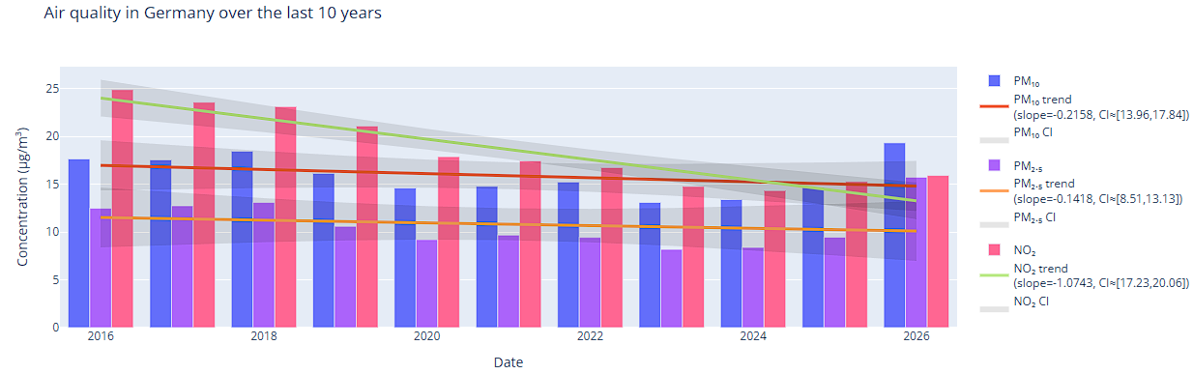
Research Questions - Trends in Germany
How did the average values of PM₁₀, PM₂.₅ and NO₂ change in Germany?
A slight decrease in fine dust and a significant decrease in NO₂ suggest that air quality has improved over the past 10 years
Notes:
- over the last 10 years
You can see the regression lines and also the values of the slopes, so it is clear that they are declining.
The confidence interval varies over time because it represents the uncertainty of the regression estimate at each point, which is lowest near the centre of the data and increases toward the edges.
at the beginning and end of the time series, fewer surrounding data points provide support for the trend.
- pollution for fine dust particles remains fairly constant, with a small declining trend visible
- For NO₂, however, there is a strong downward trend, indicating that the overall air quality has been increasing over the past 10 years.
- cause for this could be a general push for environmental awareness

Slide 14
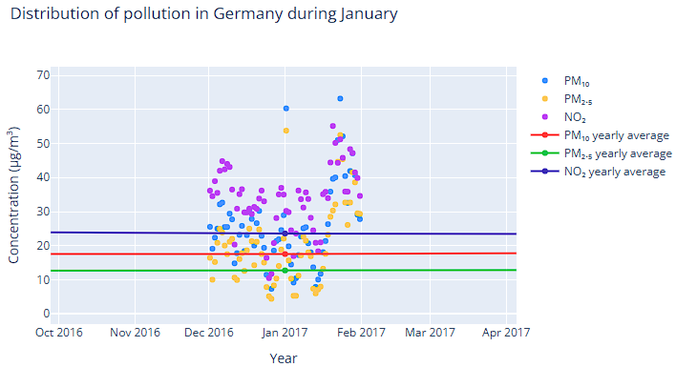
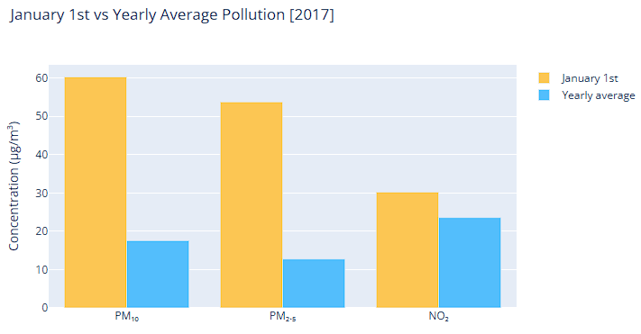
Research Questions - New Years
How does air pollution in Germany behave around New Years?
Significant spikes in PM₁₀ and PM_{2.5} (especially on January 1 due to fireworks), while NO₂ was only slightly higher than the annual average
Notes:
here we only focus on 2017 for all our pollutants.
Most points cluster around the yearly mean, with some pretty extreme outliers
Especially on January 1st, the values are much higher than the yearly average, showing that the fireworks do drastically increase fine dust particle pollution.
For NO₂, however, there doesn't seem to be a significant difference.
The reason could be that people stayed home for the celebration.

Slide 15
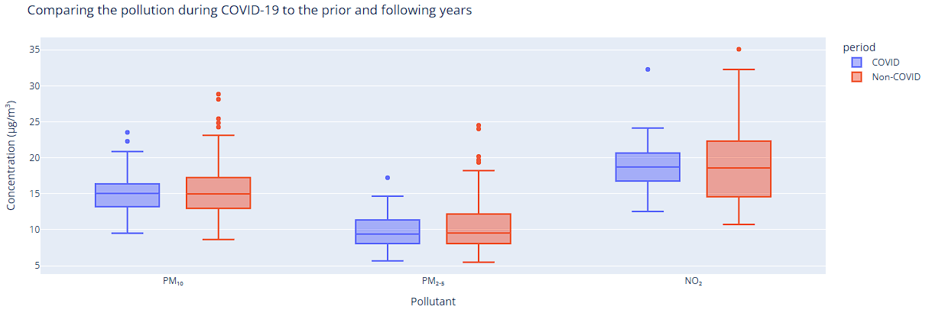
Research Questions - COVID-19
How did COVID-19 lockdowns and restrictions affect air pollution in Germany compared to the previous and following years?
There are hardly any noticeable differences between the COVID and non-COVID periods, as the distributions and median values of the pollutants largely overlap
Notes:
The third question was: How did COVID-19 lockdowns and restrictions affect air pollution in Germany compared to the previous and following years?
Here you can see the blue ones describe the corona data and the red ones the years before and after corona.
Hardly any differences are noticeable between the COVID and non-COVID periods, as the distributions and median values of the pollutants largely overlap, and therefore no significant impact of the pandemic is visible.

Slide 16
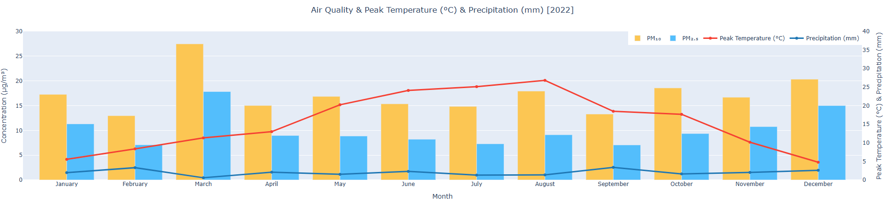
Research Questions - Weather
How did temperature and precipitation influence PM₁₀ and PM₂.₅ concentrations in major German cities between 2016 and 2025?
Peak temperature and precipitation seem to have no impact on air pollution

Slide 17
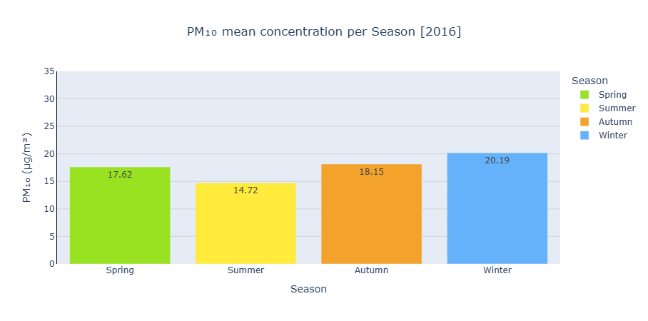
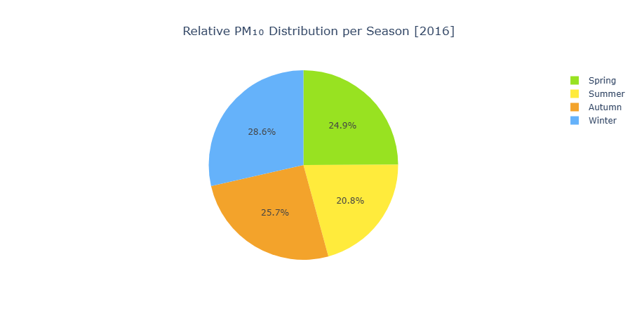
Research Questions - Seasons
How do seasonal changes influence the pollution concentrations in Germany between 2016 and 2025?
Winter consistently more polluted, summer relatively clean

Slide 18
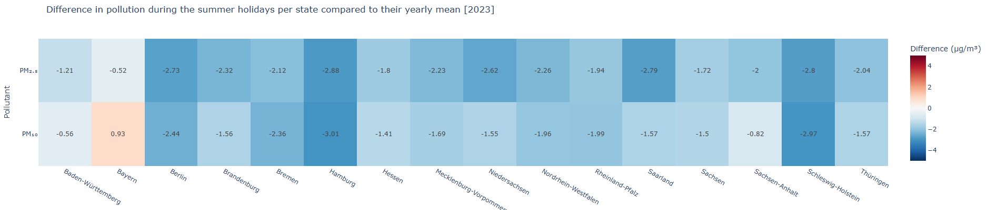
Research Questions - Holidays
How did summer school holidays in German federal states affect PM₁₀ and PM₂.₅ concentrations over the past ten years?
School holidays consistently cleaner, suggesting people leave the country or don’t commute much / stay at home

Slide 19
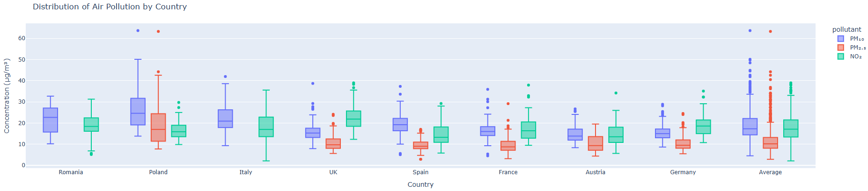
Research Questions - Countries
How does Germany compare to other countries in terms of the average concentrations of PM₁₀, PM₂.₅, and NO₂?
In comparison, Germany’s avg. PM₁₀ and PM₂.₅ values are below average, while the avg. NO₂ value is above average

Slide 20
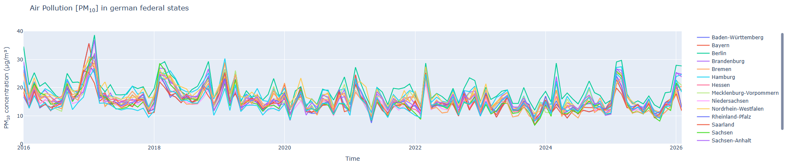
Research Questions - States
How does the air quality vary between the different german federal states?
Very similar pattern across all federal states for PM₁₀, PM₂.₅, and NO₂

Slide 21
Website

Slide 22

Website
Live demo!

Slide 23
Thank you!

